Slide 1

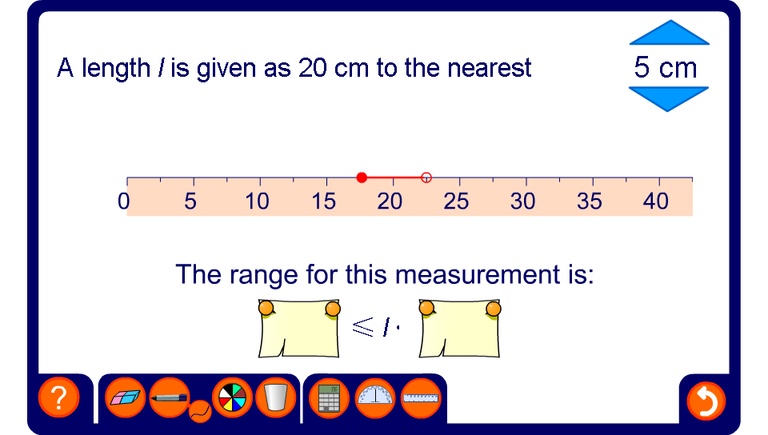


Upper and lower bounds
Notes:
Stress that when we illustrate an inequality on a number line, the value indicated by the empty circle is not included.

